Slide 1
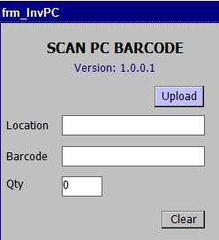
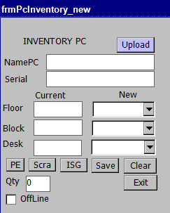
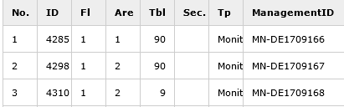
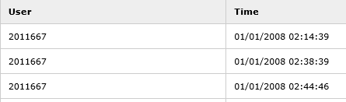

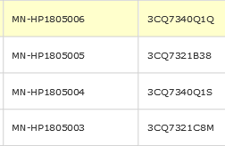
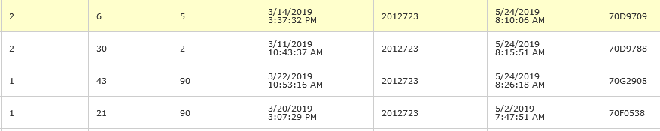
PC Inventory
Developer : Nguyen Nhu Minh
Apply: 05/2019
Expn: 0 USD
Save: Improve quality
◆Before
◆ After
User do not exactly position lastest scan then can not check information.
User know exactly position when scan.
User input position by hand not available options position to easy wrong.
Have available options position and hotkeys to transfer location.
Use want to know last time login and last time scan to look for two report.
User can check last time scan and last time login to one report.
Computer infor input by hand and cannot check lastest information
Dont have hotkey and available options position for transfer to famous location
Must to check on 2 report for review result.
Scan barcode to check exactly old PC’s position
Transfer, return PC to PE, Scrap, ISG just 1 click
Combine all information to 1 report.

